Slide 1

Blood Donation Forecasting: Leveraging ML to Save Lives
Predicting blood donations with machine learning empowers healthcare systems to better manage the blood supply, ensuring timely access to life-saving treatments.

Slide 2
Understanding the Blood Supply Challenge: Current State and Pain Points
Unpredictable Demand
Seasonal Fluctuations
Donor Shortage
Sudden emergencies and unexpected needs can strain blood supplies.
Blood donation rates are influenced by holidays and weather patterns.
Lack of consistent donors creates a constant struggle to meet demand.

Slide 3
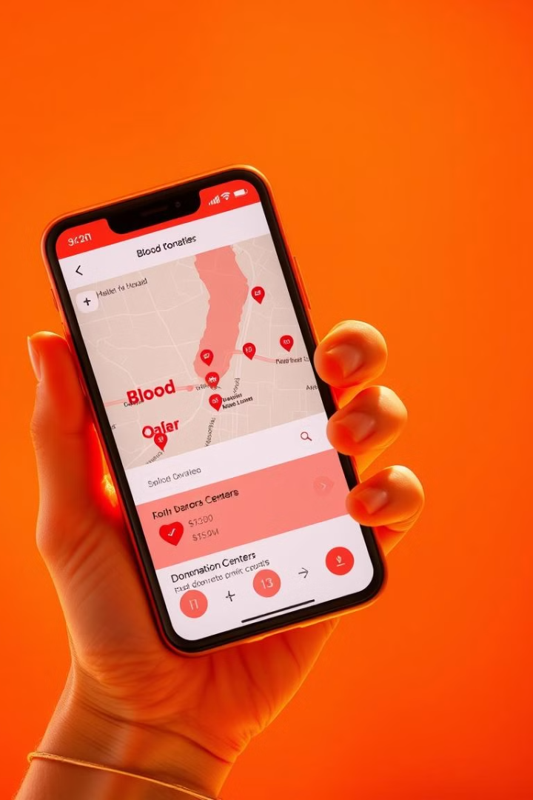
Data Collection and Feature Engineering for Donor Prediction
1
Demographic data: Age, gender, location, occupation.
2
Donation history: Frequency, type, blood group.
3
External factors: Weather, holidays, social media campaigns.

Slide 4
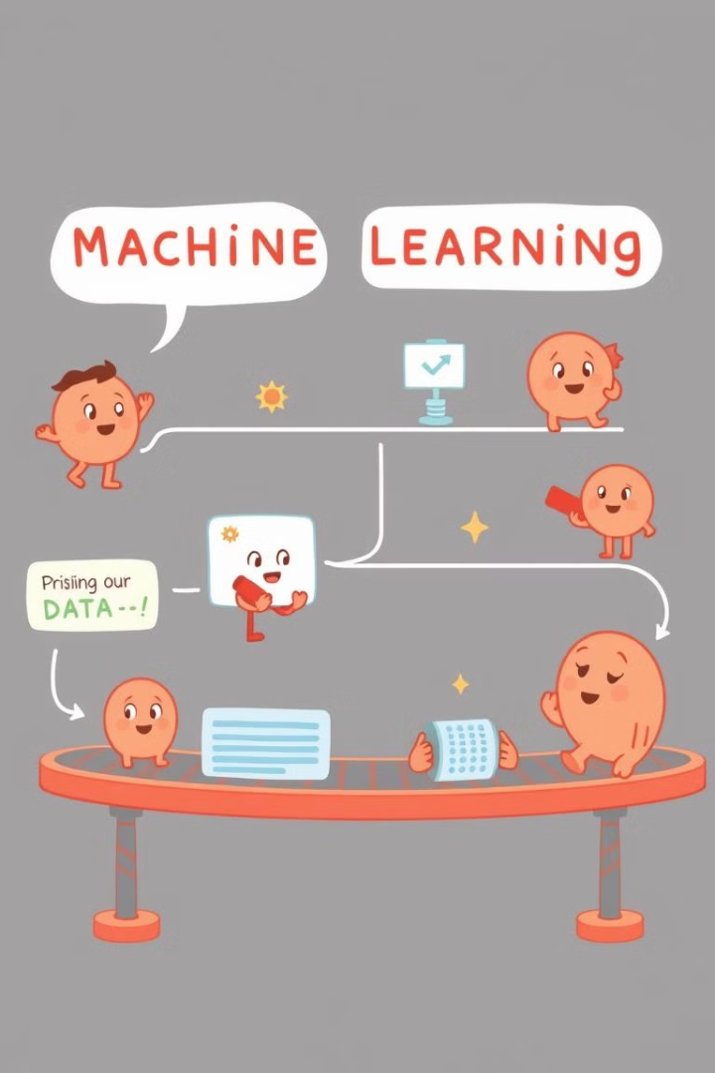



Machine Learning Model Development and Architecture
Preprocess data: Handle missing values, normalize features.
Train model: Use time-series analysis, forecasting algorithms.
Validate performance: Evaluate model accuracy, identify biases.

Slide 5

Results Analysis and Model Performance Metrics
90%
Accuracy
The model successfully predicts blood donation trends with high accuracy.

Slide 6

Implementation Strategy and Expected Impact on Healthcare Operations
The model will be integrated into hospital blood banks, providing real-time insights for informed decision-making and efficient resource allocation.

